Slide 1


PACMAN® with AI and
Reinforcement Learning integration
Foundations of AI - Team 6
Group Members:
Tanay Pandya: pandya.t@northeastern.edu
Shibin Cai: cai.shib@northeastern.edu
Rohan Bhatane: bhatane.r@northeastern.edu
Khoa Nguyen: nguyen.khoa@northeastern.edu

Slide 2
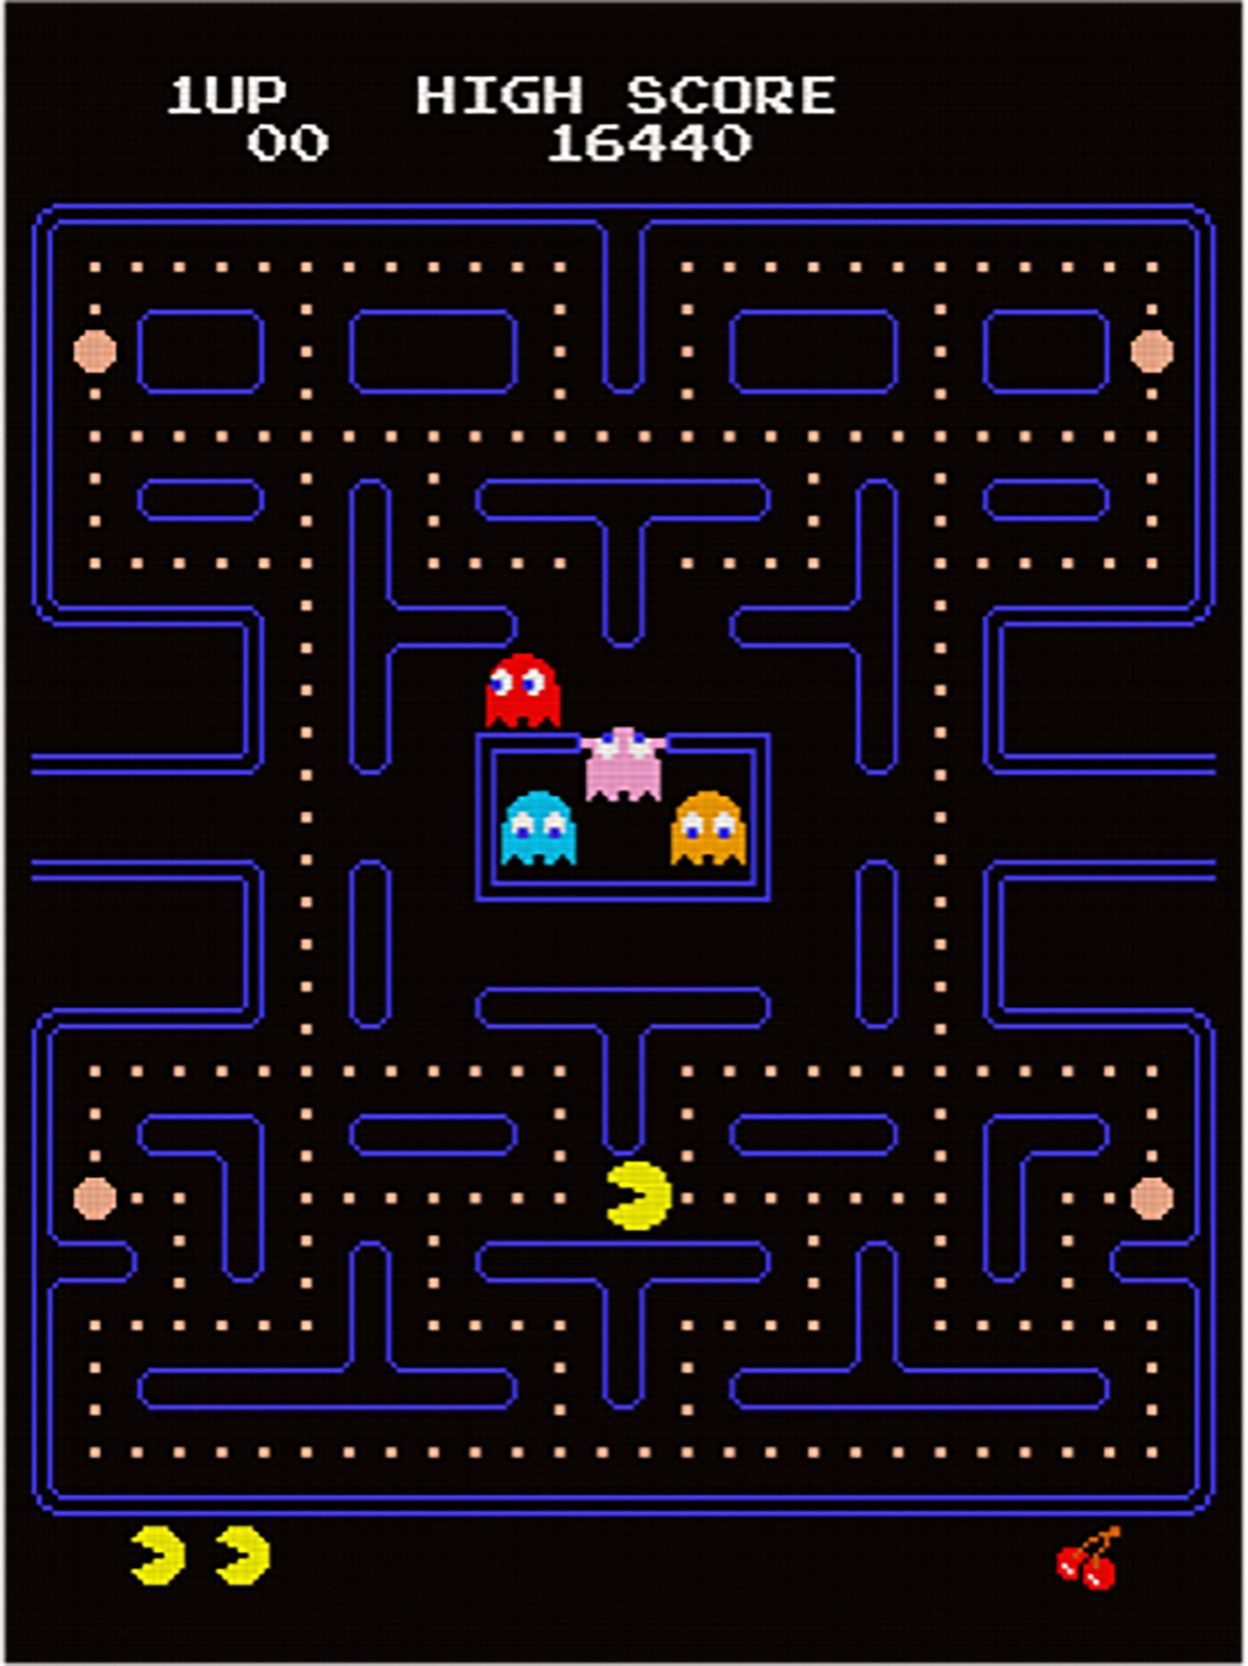
PACMAN®
(The game, not the package manager for Arch Linux enthusiasts)
Objective and win condition
Maze properties

Slide 3
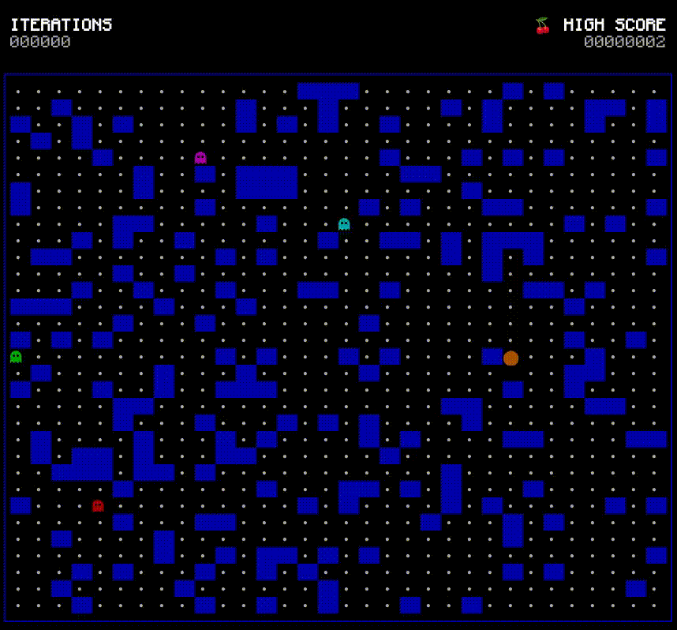
Project Implementation
Game grid, rules, and basic mechanics
Maze generation and optimization
Path finding and decision making
32x32 - 20% walls - Seed 0

Slide 4
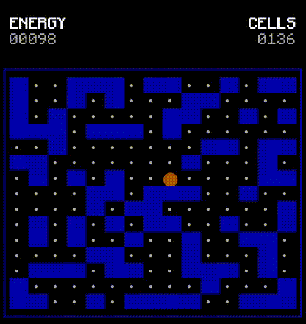
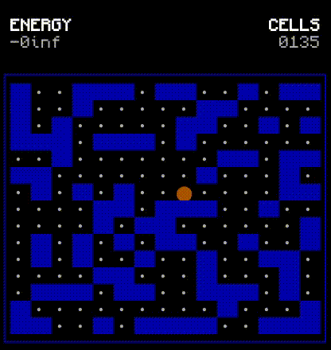
Maze Optimization
BFS algorithm used for Maze optimization
Hill climbing to compare Energy and Number of reachable cells
Removing random walls to match energy and number of reachable cells

Slide 5

A Star Algorithm
Pacman and Ghosts both use variations of A* for pathfinding
Pacman’s Heuristic:
Min(RewardDist) , Max(EnemyDIst)
Ghost’s Heuristic:
Min(AgentDist)

Slide 6
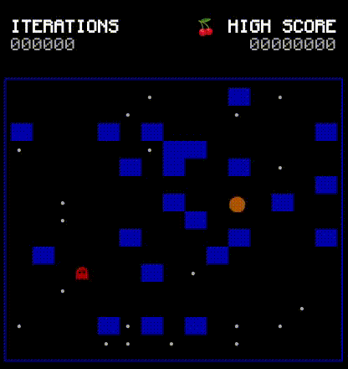
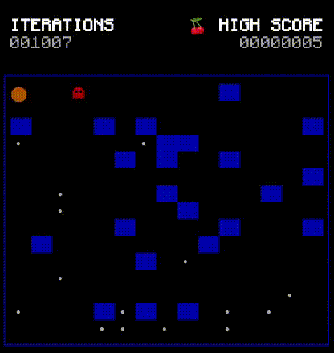
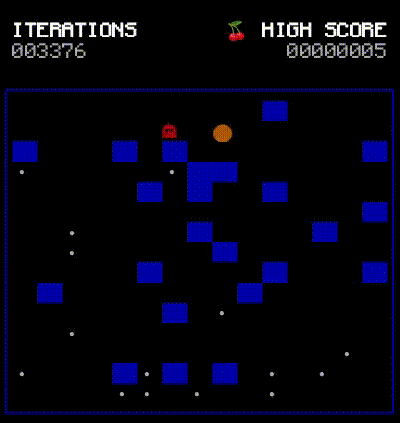
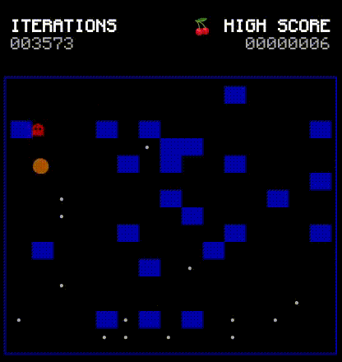
Q Learning Algorithm
States
Whole maze current status
Actions
UP DOWN RIGHT LEFT
Rewards
-inf for walls
10 for rewards
-100 for enemy
-0.01 for empty cell

Slide 7
Conclusion and Retrospection
Why we made this project to begin with?
What we learned:
A* is efficient with proper heuristic
Q learning is optimal but slow in dynamic environment
Further improvement:
Deep Q learning
Q Star

